Slide 1
Title 1 Presentation
Presented by:
Ms. Moore williams and Ms. Pryer

Slide 2
Sign -In

Slide 3
AGENDA
Sign-In /Introductions
Ronald Garlington, Principal
Wanda Moore Williams, Asst. Principal @The DEN
Shayla Pryer, Master Teacher Leader @The Den
What You Need to Know About Title I
What is Title 1?
What is the Schoolwide Improvement Plan (SIP) and what are the SIP goals?
What curriculum does our school use?
What tests will my child take?
Parent and Family Engagement
How Will We Communicate And Partner With Families?
What Is The School-parent Compact?
What Is The School Parent And Family Engagement Plan?
What Is The District Parent And Family Engagement Statement?
What Opportunities And Events Will The School Offer Students & Parents?
Closing
Notes:
https://docs.google.com/forms/d/e/1FAIpQLSf8GWqGvcaKVqXUdCUr18OQc_TgClzXuBL0SXkAc9QGFKqV8w/viewform?usp=sf_link

Slide 4
What Is Title I ?
Title 1 the largest federal aid program for public schools in the United States.
Title 1 is designed to support state and local school reform efforts tied to the challenging state academic standards to improving teaching and learning for students.
Title 1 programs must be based on effective means of improving student achievement and include strategies to support parent and family engagement.
Notes:
This is where you will share a definition of Title I.

Slide 5
YOUNG’S SCHOOL IMPROVEMENT PLAN (SIP)
Measured by milestones, ELA - (Lvl 3 and up) will increase from 17% to 20% and (Lvl 2 and up) will increase from 48% to 51%
As measured by milestones, math - (Lvl 3 and up) will increase from 13% to 16% (Lvl 2 and up) will increase from 47% to 50%
Increase ADA from 87.8% to 90% by May 2025.

Slide 6
Attendance Matters Wolfpack !
Perfect attendance students will be invited to monthly celebrations.
Students will receive 100 wolf bucks for perfect attendance.
Weekly check-ins, groups, and incentives will be given to students who have been referred for attendance support.
The grade level with the highest percentage of attendance for the month will be announced on the morning show or intercom.

Slide 7
CURRICULUM AT YOUNG
ELA
MATH
SCIENCE
SOCIAL STUDIES
https://www.georgiastandards.org/Georgia-Standards/Pages/default.aspx

Slide 8
ASSESSMENTS AT YOUNG
TESTS | WHEN | HOW IS PROGRESS MEASURED | PROFICIENCY LEVELS
MAPP | Aug Jan & April | The Measures of Academic Progress (MAP) assessment is designed to measure a student's academic achievement and growth over time in reading and mathematics. Together with other classroom-based information, MAP results can help teachers make instructional decisions that match the needs of each child. | MAP results are provided as a numerical RIT score. This score is used to measure a student’s achievement level at different times of the school year and compute growth.
Exit Tickets | Weekly | Assesses student mastery of grade level standards | 70%
Quizzes & Tests | 1-2 Times a Quarter | Assesses student mastery of grade level standards | 70%
Milestones | May | Georgia Milestones measures how well students have learned the knowledge and skills outlined in the state- adopted content standards in English Language Arts, Mathematics, Science, and Social Studies. | Beginning Learner, Developing Learner, Proficient Learner, and Distinguished Learner.

Slide 9
The School-Parent Compact, School Parent and Family Engagement Plan and The APS Parent and Family Engagement Statement
https://www.atlantapublicschools.us/young

Slide 10
School Parent and Family Engagement Plan The plan establishes the school’s expectations for parent and family engagement and describes how our school will implement a number of specific parent and family engagement activities, and it is incorporated into the school’s plan submitted to the local educational agency (LEA). School Parent Compact School parent compact outlines how the parents, the entire school staff, and the students will share the responsibility for improved student academic achievement as well as describes how the school and parents will build and develop a partnership that will help children achieve the state’s high standards. District Parent And Family Engagement Statement The statement establishes Atlanta public school’s expectations and objectives for meaningful parent and family engagement and describes how the district will implement a number of specific parent and family engagement activities, and it is incorporated into the lea’s plan submitted to the Georgia Department of Education.
SCHOOL COMPACTS AND PLANS WILL BE DISTRIBUTED ONLINE AND THROUGHOUT THE SCHOOL YEAR

Slide 11
PARENT AND FAMILY ENGAGEMENT PLAN
FOR STUDENT SUCCESS

Slide 12
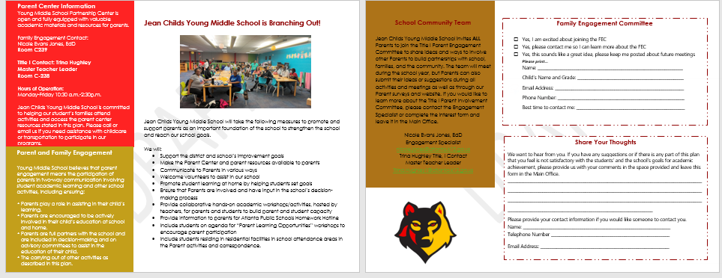

Slide 13
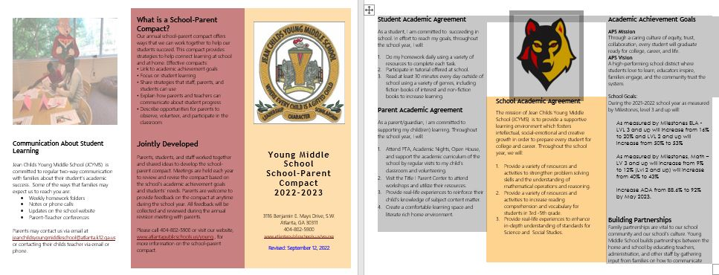
School-PARENT compact

Slide 14
STUDENT Supports
Social Emotional Well Being
Mental health services: licensed mental health providers in the school building supporting individuals, student groups, and families; Zen zones: designated peaceful spaces for students to utilize when they need room to calm down and self-regulate; Restorative practices: mending harm done in the school community to build stronger relationships on the other side of conflict.
Academic Success
Tutoring : 1:1 or in small group academic support; study groups: guided subject-focused small group sessions.
Basic Needs Support
Uniforms: dressing our students for success every day; school supplies: ensuring students have the tools they need to learn; personal health: personal hygiene supplies as well as feminine care kits to support rapidly changing middle school bodies and fill the gaps that may exist at home.
ACCESS AND EXPOSURE
Exploring beyond the school walls via extracurricular activities: clubs, field trips, sports, and more; student-to-student mentoring: bringing together students across the mays cluster for academic as well as special interest mentoring; career exploration: exposure to a variety of career paths to expand student’s awareness of post-secondary opportunities.
Developing students, Engaging stakeholders, and Networking with Community Partners

Slide 15
Parent and family engagement
Parent and family engagement is an ongoing process that increases active participation, communication, and collaboration between parents, schools, and communities with the goal of educating the whole child to ensure student achievement and success.

Slide 16
1st Semester Parent/family engagement events
9/10 - PTA
9/11 – Seven Courts Community Resource Event (#2)
09/19 - Go Team Meeting
09/20- La fiesta plaza field trip
09/25-09/26- Latin Dance lesson hosted by Tanika vincent
9/22 - PTA Meeting via Zoom, 6:15pm
10/02-10/03- latin dance lessons hosted by Tanika Vincent
10/04- Dulce para los maestros sweet treat for teachers
10/10- Student vs. Faculty soccer game @5:10 p.m.
10/11-savor the flavor fall fiesta during connections
11/13 – Go Team Meeting
11/15 - Coffee & Conversation w/Principal Garlington in Media Center, 9:45am
11/17 – “Muffins for Moms” Drive-up Event via Bus Lane, 9:30am-10:30am
TBD - Winter Holiday Program
12/04-Go Team Meeting
12/15 – “Doughnuts for Dads” Drive-up Event via Bus Lane, 9:30am-10:30am
Parents and families, we look forward to you joining us for these opportunities and events. If you are interested in getting involved, please reach out to shayla.pryer@atlanta.k12.ga.us

Slide 17
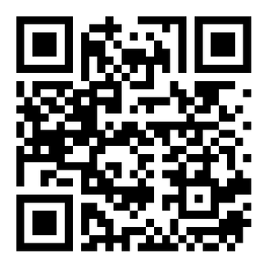
QUESTIONS/Concerns
Give us your feedback!
How can we help?
Do you have any questions?
THANK YOU FOR ATTENDING!
REMEMBER TO SIGN IN & OMPLETE OUR SURVEY!

